Slide 1

FAMILY TREE AND BLOOD RELATIONS LOGICAL REASONING

Slide 2
Read the following information carefully and answer the question below. 1. J + K means J is the son of K 2. J - K means J is the wife of K 3. J x K means J is the brother of K 4. J ÷ K means J is the mother of K 5. J = K means J is the sister of K What does A x B ÷ C mean?
a. A is the brother of C
b. A is the father of C
c. A is the uncle of C
d. A is the nephew of C

Slide 3
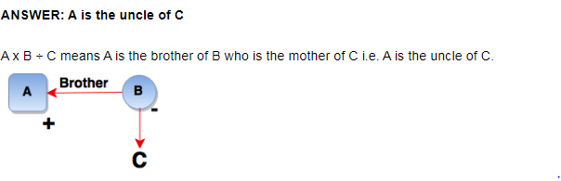

Slide 4
2. Read the following information carefully and answer the questions below. 1. J + K means J is the son of K 2. J - K means J is the wife of K 3. J x K means J is the brother of K 4. J ÷ K means J is the mother of K 5. J = K means J is the sister of K What does A + B – C mean?
a. C is the father of A
b. C is the uncle of A
c. C is the son of A
d. C is the brother of A

Slide 5
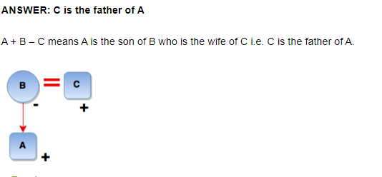

Slide 6
3. Read the following information carefully and answer the questions below. 1. In a family of six persons, L, M, N, F, P, Q, there are two married couples. 2. F is grandmother of L and mother of M. 3. N is wife of M and mother of Q. 4. Q is the grand-daughter of P. Who among the following is one of the couples?
a. N-F
b. F-P
c. P-M
d. None of these

Slide 7
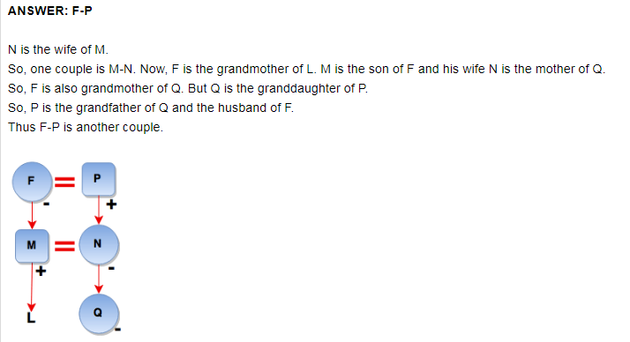

Slide 8
4.Read the following information carefully and answer the questions below. 1. In a family of six persons, L, M, N, F, P, Q, there are two married couples. 2. F is grandmother of L and mother of M. 3. N is wife of M and mother of Q. 4. Q is the grand-daughter of P. Which of the following is true?
a. L is the brother of Q.
b. L is the sister of Q.
c. M has three daughters.
d. None of these

Slide 9
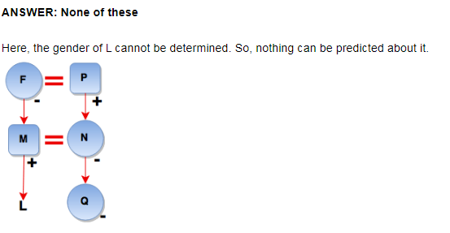

Slide 10
5. Read the following information carefully and answer the questions below. 1. In a family of six persons, L, M, N, F, P, Q, there are two married couples. 2. F is grandmother of L and mother of M. 3. N is wife of M and mother of Q. 4. Q is the grand-daughter of P. How many male members are there in the family?
a. 1
b. 2
c. 3
d. Cannot be determined

Slide 11
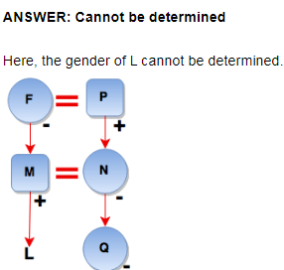

Slide 12
6. Read the following information carefully and answer the question below. 1. Rohansh is the son of Aryansh’s father’s sister. 2. Somit is son of Disha who is mother of Aarav and Grandmother of Aryansh. 3. Lalit is the father of Ananya and grandfather of Rohansh. 4. Disha is wife of Lalit. How is Disha related to Rohansh?
a. Aunt
b. Grandmother
c. Sister
d. Cousin

Slide 13
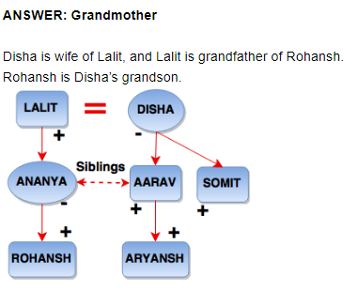

Slide 14
7. Read the following information carefully and answer the question below. There are six children playing football, namely, Z, Y, X, W, V and U. 1. Z and V are brothers. 2. U is the sister of V. 3. X is the only son of Z’s uncle. 4. Y and W are daughters of the brother of X’s father. How many male players are there?
a. 3
b. 4
c. 5
d. 6

Slide 15
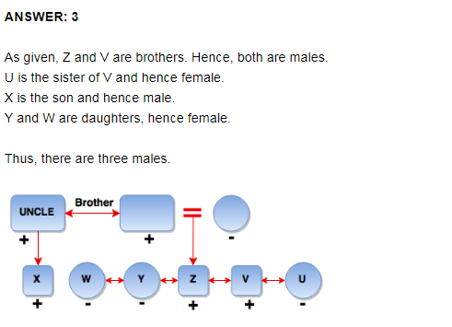

Slide 16
8. Pointing towards a girl, a man said to a woman, “Her mother is the only daughter of your mother.” How is the girl related to that woman?
a. Sister
b. Daughter
c. Aunt
d. Wife

Slide 17
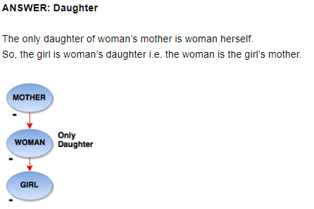

Slide 18
9. Pointing to Raja, Rani said, “His mother’s brother is the father of my son Rajkumar”. How is Raja related to Rani?
a. Niece
b. Nephew
c. Aunt
d. Sister

Slide 19
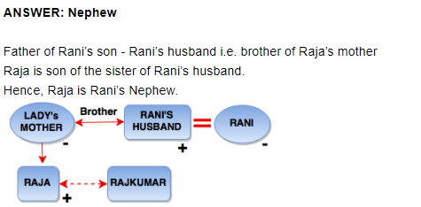

Slide 20
10.Pointing to a man, Rohan said, “His only brother is the father of my daughter’s father.” How is the Rohan related to the man?
a. Father
b. Grandson
c. Uncle
d. Nephew

Slide 21
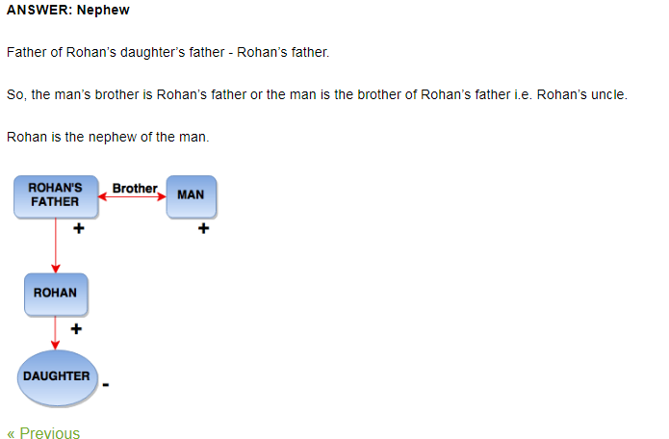

Slide 22
11. Pointing to an old woman, Aryan said ‘’Her son is my son’s uncle.” How is Aryan related to old woman?
a. Mother
b. Sister
c. Son
d. Daughter

Slide 23
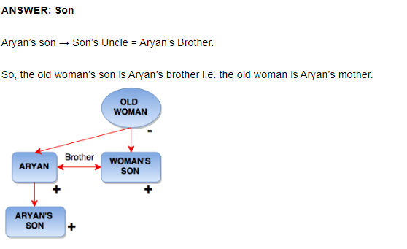

Slide 24
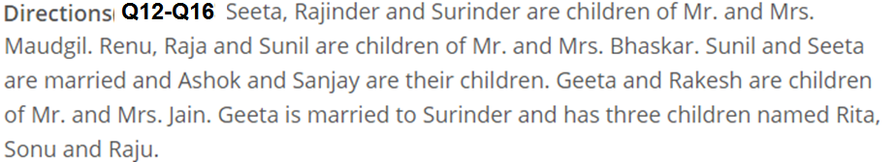

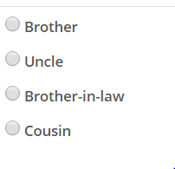
12.
A
B
C
D

Slide 25
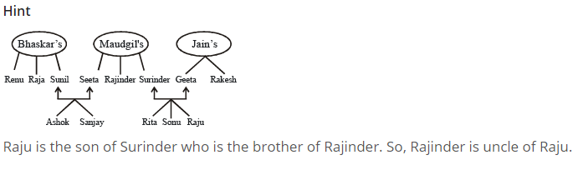

Slide 26

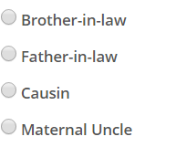
13.

Slide 28

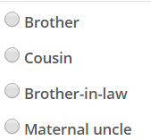

14.

Slide 30


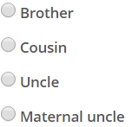
15.

Slide 32

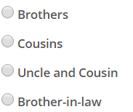
16.

Slide 33
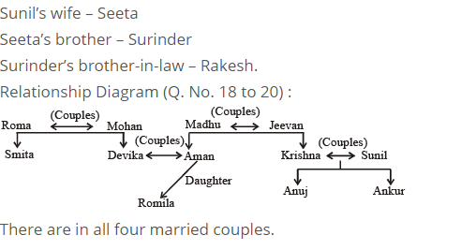

Slide 34
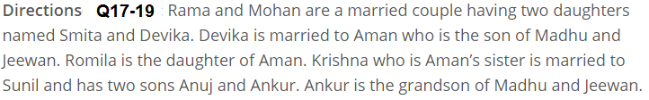

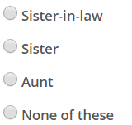
17.

Slide 36

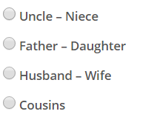
18.

Slide 38


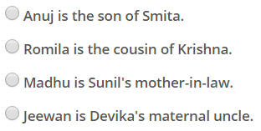
19.

Slide 39


Slide 40

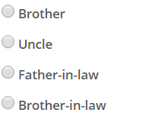
20.

Slide 41


